Slide 1
DISS v3.x Onboarding Presentation
16.06.2017
Author: Greg. Kavvadias (kavvadiasg@unisystems.gr)

Slide 2
Overview
Diss v3.x bird’s eye view
Input tier
Processing Tier
Output tier
Architecture and information flow within DISS
DISREG & IUCLID
DISLIST
Exceptions
C&L

Slide 3
Input Items, Processing, Output Items
Processing
DISREG
DISLIST
C&L
Input
Output

Slide 4
Acronyms – Concepts
RML
The RML (Regulatory Master List) aims at a standardized substance centric view of the ECHA’s disseminated data.
The RML is associated with the disseminated output of all processes to a greater or less extent. (ICBP)
C&L
Dissemination Processes
DISREG (Reach Registrations)
DISLIST (Dynamic Case Lists)
DISCNL (Notified Classifications)
DISCLH (Harmonised Classifications)
DPC (Middle Tier)
DPA (Output Tier)
DWP (Dissemination Web Panel)
IC (Info Card) & BP (Brief Profile)
Input item & Output item
Staging & Live

Slide 5
DISS v3.x Bird’s eye view
Input Tier
Processing Tier
Output Tier

Slide 6
Input Tier
REACH IT
Reach Registrations
Notified classifications (C&L)
CLP Classifications (C&L)
DC
DISLIST related data (Candidate List, Authorisation List, Restriction List, CoRAP substance, evaluations, Registration of intentions, Evaluation decisions, Annex III)
CFD Assessments
DFS Services (Documentum Foundation services)
Classlab
Harmonised Classifications data (C&L)
PIC
R4BP

Slide 7
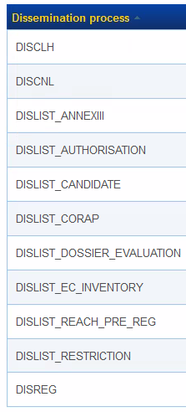
Processing tier
11 current processes
ROI lists to be added in v3.2.x
C&L
DISLIST

Slide 8
Processing tier - DPC
The DPC is the central processing component of the of DISS v3 which provides the following services:
Coordination and scheduling of Dissemination processes
Collection of BIDI data for dissemination
Providing data storage and application functionality for the DWP
Providing the control of interactions with other systems and data stores
Pushing data forward to the DPA on the staging and public environments
The DWP is essentially the GUI for the DPC and individual Process configuration

Slide 9
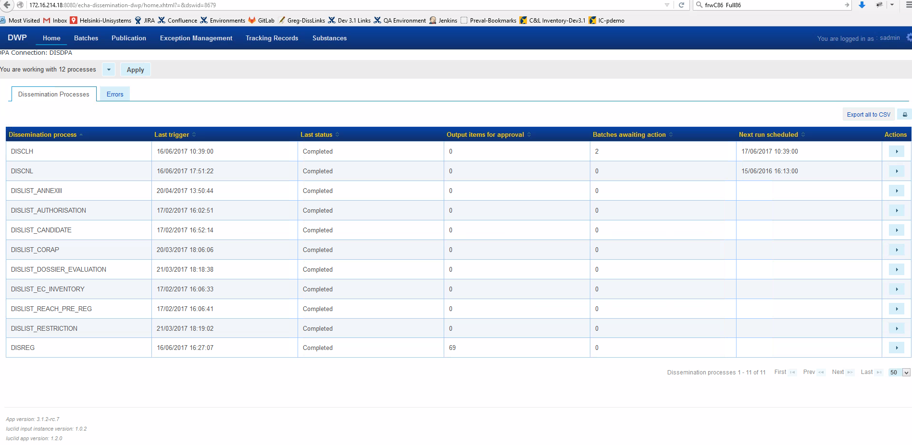
DWP: GUI of DPC

Slide 10
Processing stages

Slide 11
Output tier - The DPA
The DPA is the relational data storage application for the Output Tier. It does not provide a UI but provides data to the ECHA Portal UI by:
Providing auto complete suggestions
Providing quick and advanced search results
Providing Dissemination Processes search results
Searching and Providing the list of supported Dissemination Lists and the fields contained in each
Searching and Providing InfoCards and Brief Profiles
The ECHA Portal is the Liferay based web UI for end- users. There are two installations:
One on the Staging environment (intended for ECHA-internal end-users to valid disseminated data prior to their publication)
One on the Public environment (intended for public end-users)

Slide 12
Info Card & Brief Profile (ICBP)
The Substance Centric (RML) dissemination information includes 2 sets of data accessible from the top level ECHA web site search:
InfoCards: A summarisation of the substance in terms of:
The Substance’s identity and chemical information
Substance Classification and labelling information
Substance critical properties and any inclusion in regulatory annexes and lists.
Information about the substance including tonnage and uses
Links to the raw data
Link to the brief profile
The Brief profiles information from the registered IUCLID Dossier for the Substance REACH Registrations:
Greater depth to the InfoCard data
Scientific testing data

Slide 13
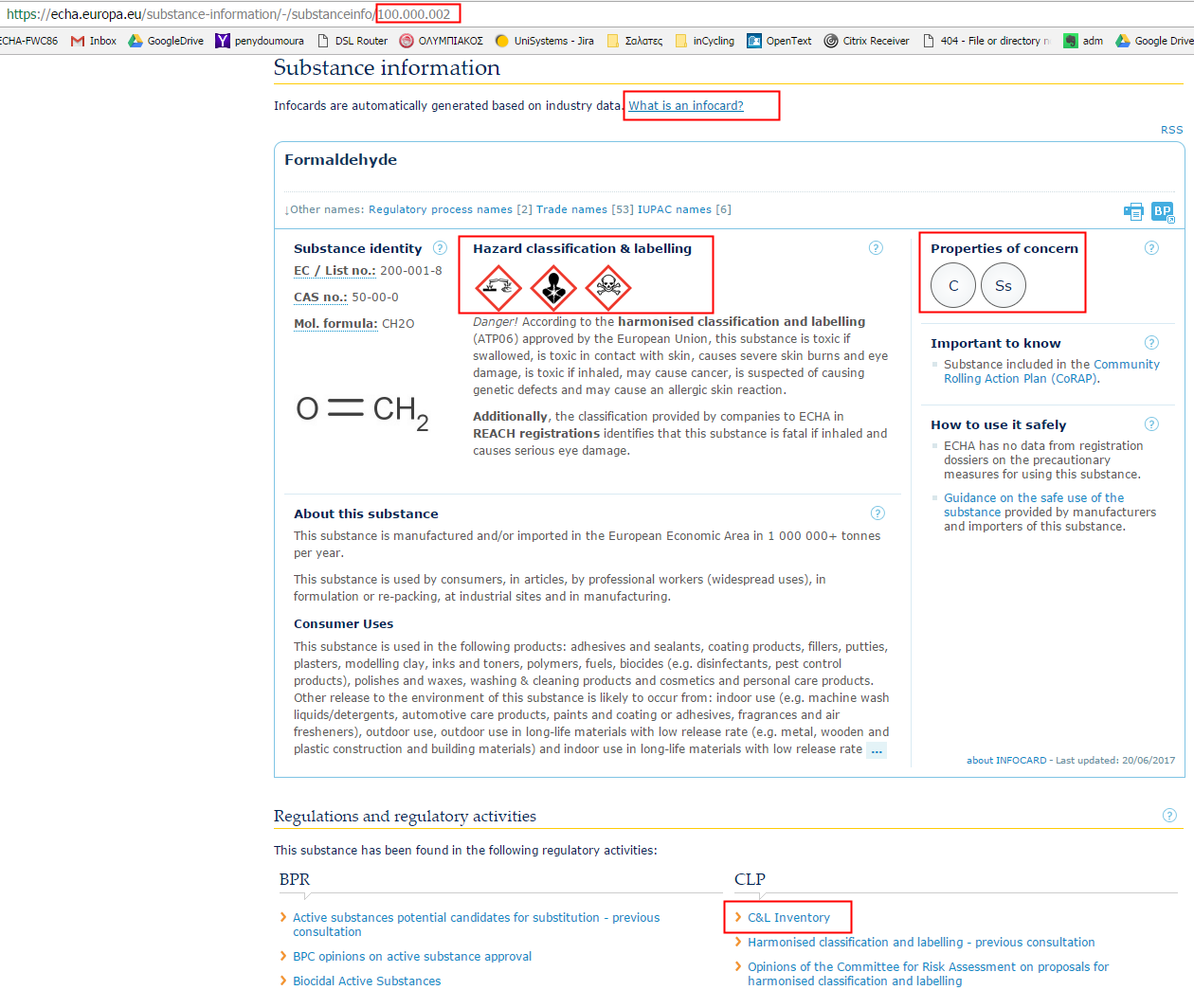
Info Card (1/2)
Notes:
InfoCards: A summarisation of the substance in terms of:
The Substance’s identity and chemical information
Substance Classification and labelling information
Substance critical properties and any inclusion in regulatory annexes and lists.
Information about the substance including tonnage and uses
Links to the raw data
Link to the brief profile
The Brief profiles information from the registered IUCLID Dossier for the Substance REACH Registrations:
Greater depth to the InfoCard data
Scientific testing data

Slide 14
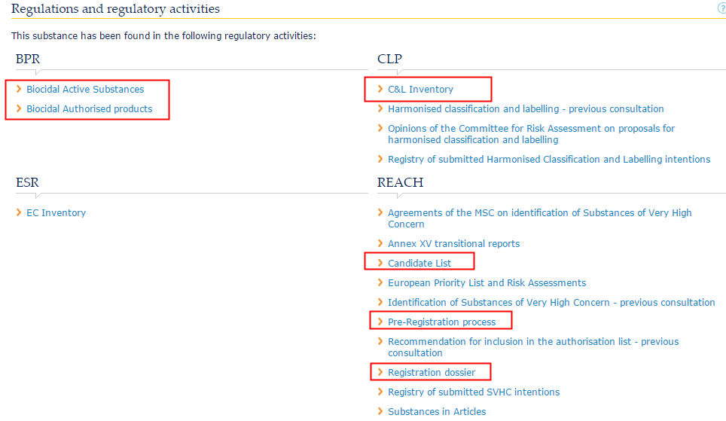
Info Card (2/2)
More info on ICBP can be found in: what_is_infocard_Final.pdf

Slide 15
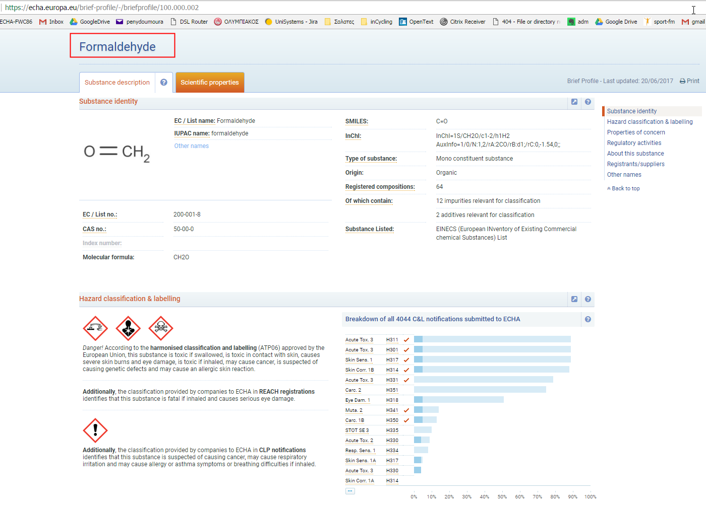
BP (Non Scientific data)

Slide 16
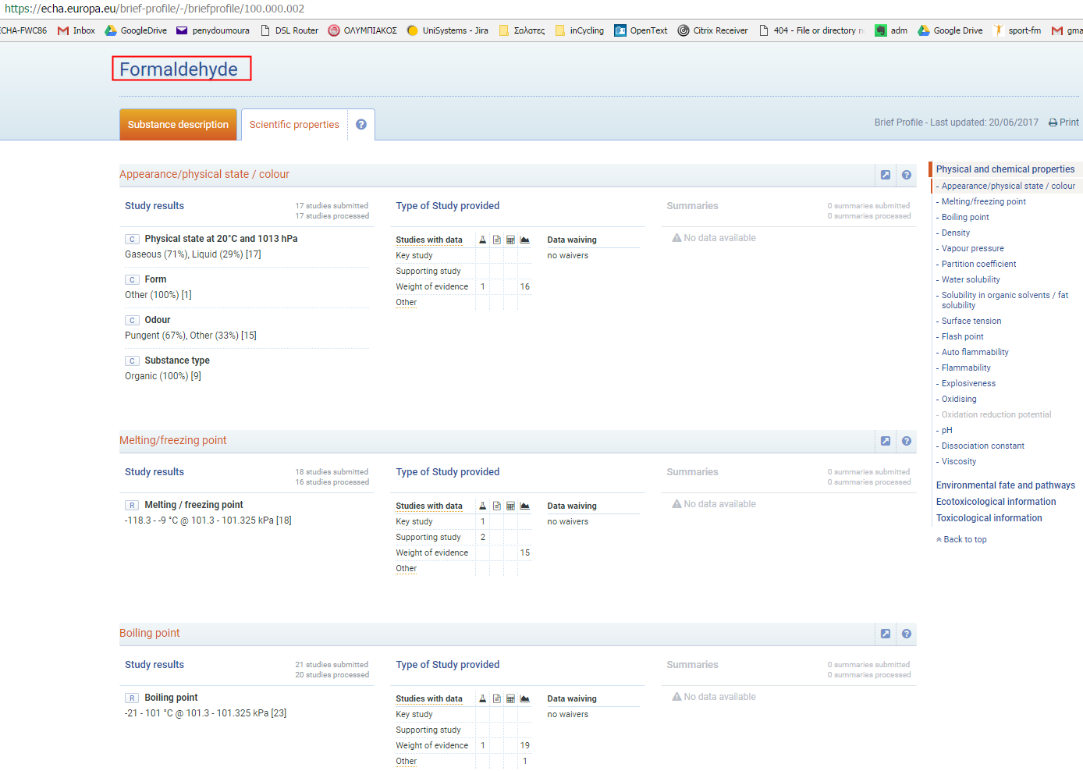
BP (Scientific Data)

Slide 17
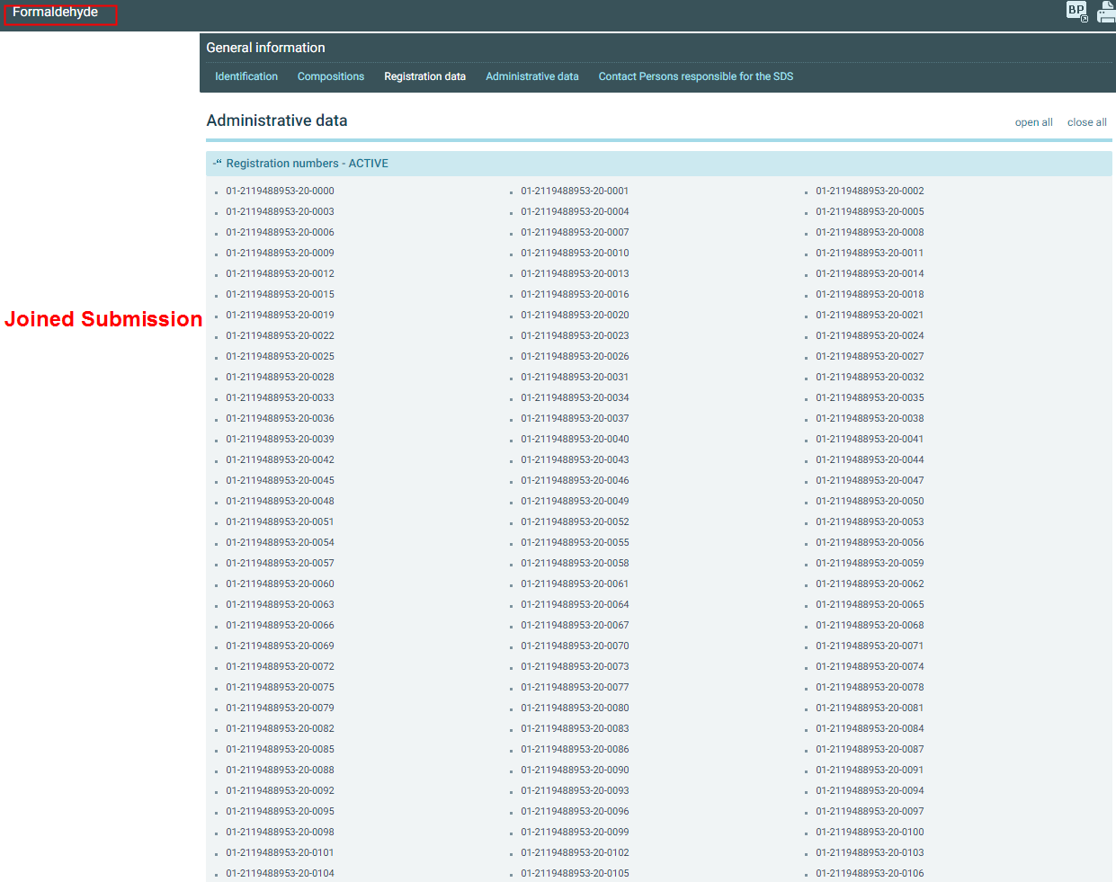
Formaldehyde –Joined Submission

Slide 18
Flow of information (1/3)

Slide 19
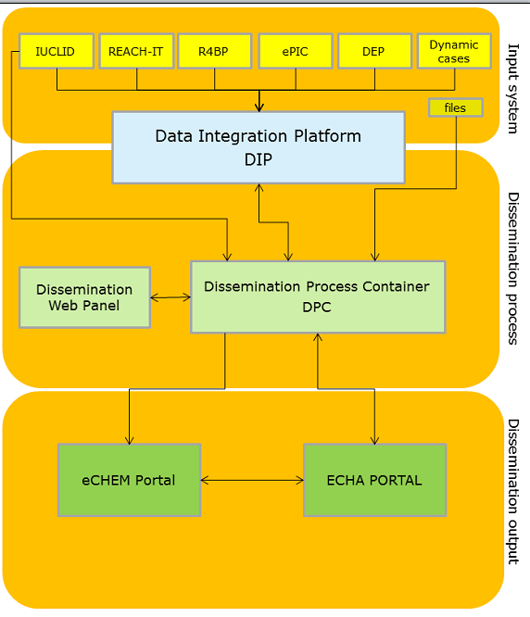
DISS: Flow of information (2/3)

Slide 20
DISS: Flow of information (3/3)

Slide 21
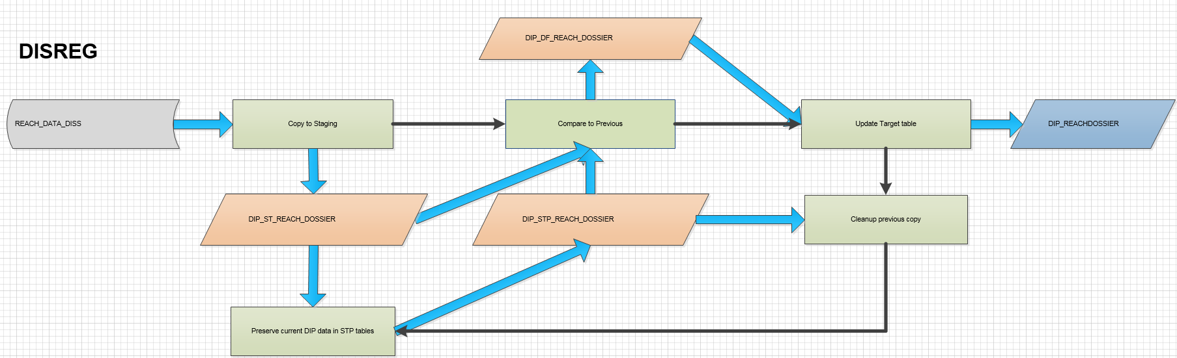
Instantiation
Instantiation updates DPC with the latest BIDI data. DPC database part, storing the latest BIDI data is called BIDI Snapshot.
Instantiation automatically cancels any batches at selection step.
The data flow is similar for the rest of the BIDI data (DISLIST, RML etc.)

Slide 22
DWP – Process types
Automated Update
Automated Full
Manual Update
Manual Full
Manual Empty
Notes:
Automated Update
the process should be run using an automated selection of new, updated, or removed input items, where changes have not yet been processed (selected by default).
Automated Full
the process should be run using an automated selection of all snapshot data (i.e. a complete re-dissemination of the data).
Manual Update
the process should be run using a manual selection to be made based on a suggested list of new, updated, or removed input items, where changes have not yet been processed
Manual Full
the process should be run using a manual selection to be made based on all snapshot data associated with the process.
Manual Empty
the process should be run using a manual selection to be made based on an empty list to be added by the user. If the specific value is chosen the pop-up interface includes also the ‘Go to select input items’ option which if selected, is navigating directly the user to the Input Item Selection page after triggering a process

Slide 23
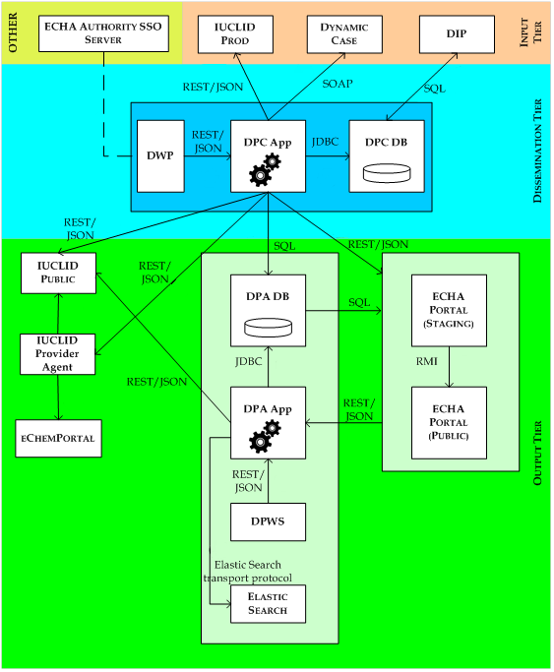
DISS Architecture overview
DIP->Renamed to BIDI

Slide 24
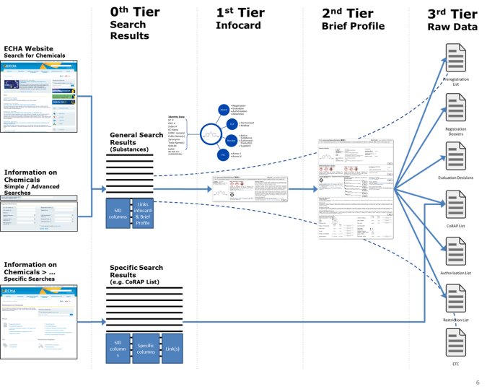
Data Flow: From Echa Portal towards factsheets

Slide 25
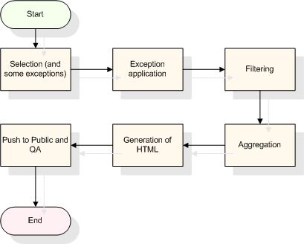
DISREG

Slide 26
DISREG Process
The DISREG process is related to processing of REACH registrations for Dissemination.
2 Submission types
Individual Submissions
Joined submissions (1 lead dossier)
Typical example: formaldehyde 100.000.002
The DISREG process uses the following input:
IUCLID Dossiers
Relational data
And produces the following output:
An aggregated IUCLID Dossier (all joint submissions members together)
Relational data on DPA for searching (Elastic Search)
A generated HTML file for web display of the Aggregated IUCLID Dossier

Slide 27
DISREG
As previously illustrated the processing of the REACH Registrations for Dissemination involves the following steps
Selection: only changed registrations are processed.
Exception application: data is either changed or registrations omitted from processing
Filtering: filtering of the Registration data and the contents of the IUCLID dossier
Aggregation: the IUCLID Dossier and Registration data from the member Registrations is compiled into single joint-submission data sets.
Generation of output files: an HTML presentation file is produced showing aggregated dossier information
Push to public and QA: the data and IUCLID dossiers are pushed first to staging, where they are subject to QA, and then the public environment.

Slide 28
DISREG & IUCLID
IUCLID application types
Summaries
Studies
Substance vs dossier
Repeatable blocks
Clipboard manager
CFD
Original dossier
Filtered Dossier
Aggregated Dossier

Slide 29

IUCLID installation types
1. Distributed environment installation
Glassfish Application server
Oracle
his type of installation is intended for use by larger companies and organisations.
2. Desktop application
aimed at SMEs, and those who simply want to try out the software.
Available for download from https://iuclid6.echa.europa.eu/download

Slide 30
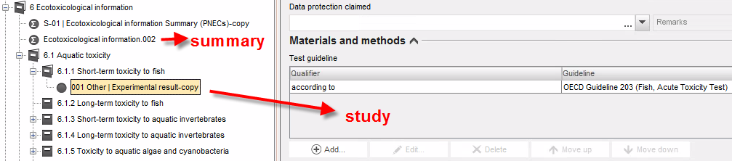
IUCLID – Study & Summary

Slide 31
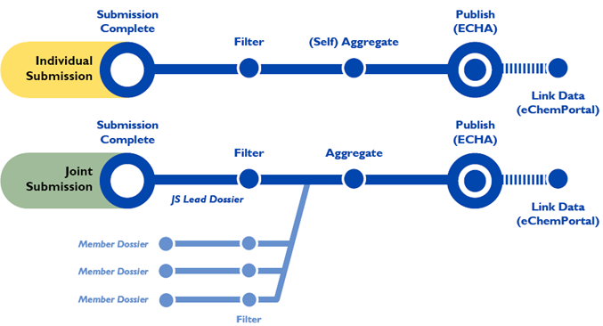
IUCLID: IS, JS, Filtering & Aggregation
IS: Individual Submission
JS: Joined Submission

Slide 32
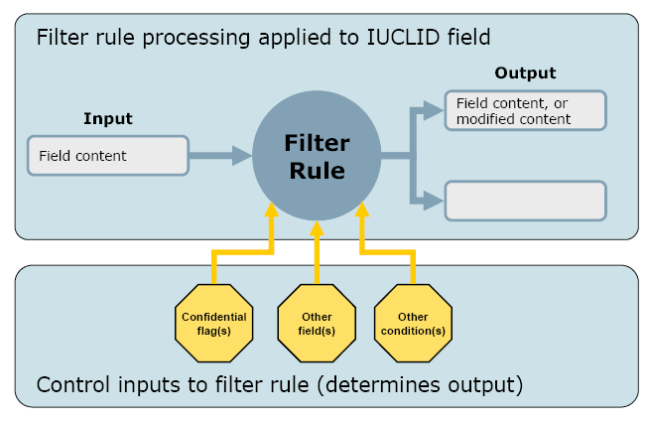
IUCLID Filtered Dossier

Slide 33
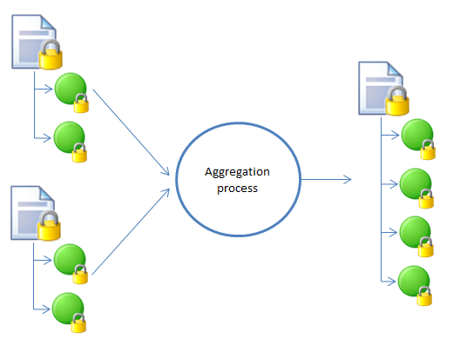
IUCLID Aggregated Dossier
The aggregated dossier has all features (structure, functionalities) of a dossier created by the default dossier creation process of IUCLID.

Slide 34
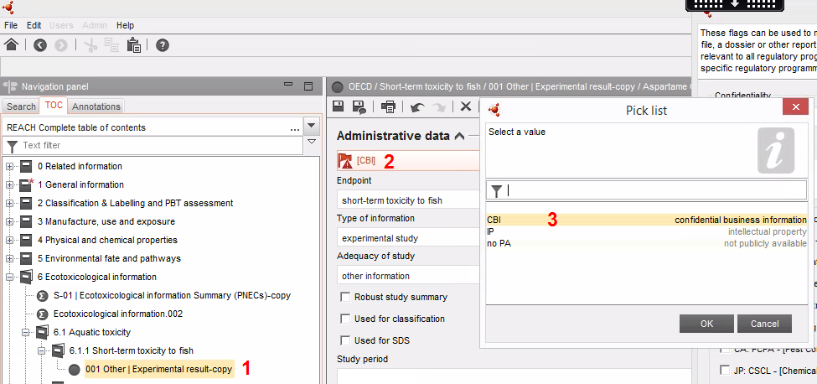
IUCLID CFD

Slide 35
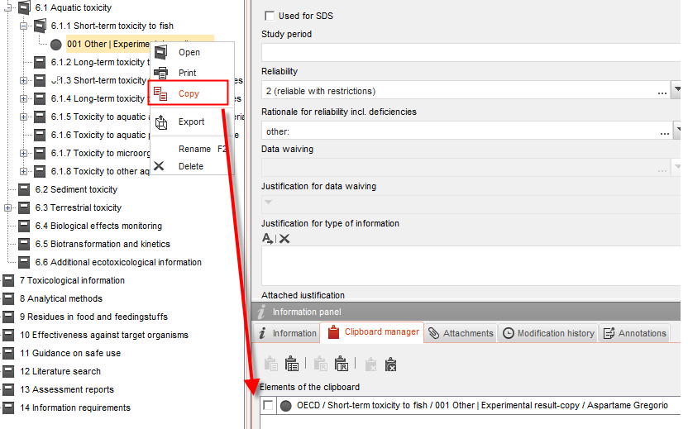
IUCLID Clipboard Manager

Slide 36
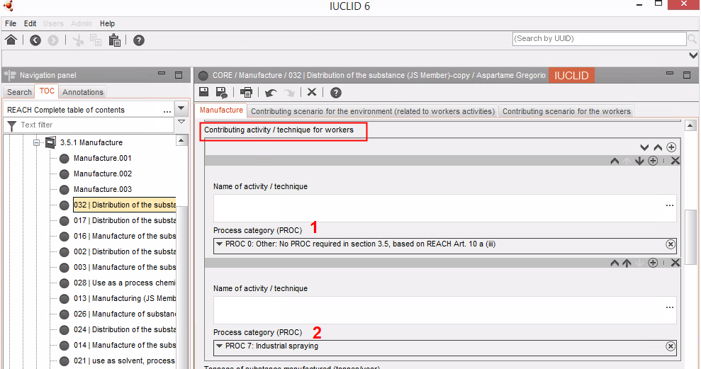
IUCLID – Repeatable blocks

Slide 37
DISLIST

Slide 38
DISLIST
The data sets to be included in DISLIST in the first version of the “DISS v3” platform are:
CoRAP: Relational data for search and details page with associated files.
The Candidate list: Relational data for search and details page with associated files
The Authorisation list: Relational data for search and details page with associated files
The Restrictions list: Relational data for search and details page
The Evaluation list: Relational data for search and associated files
The pre-registration list: Relational data for search and presentation of related files data
The Annex III: Relational data for search

Slide 39
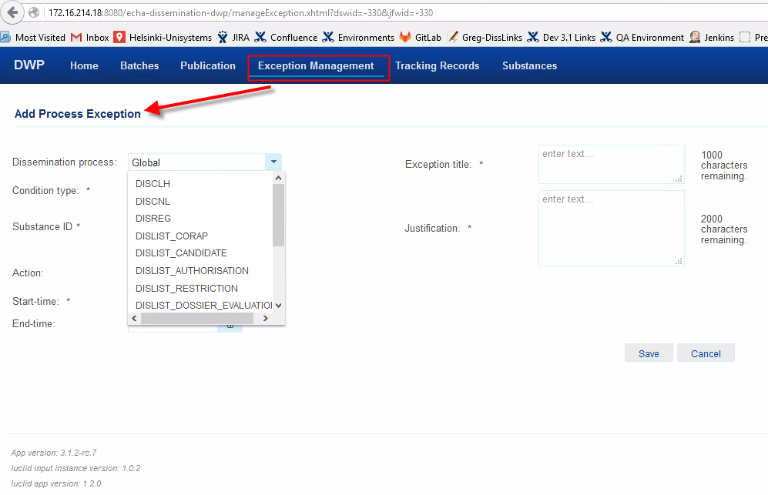
Exceptions

Slide 40
Exceptions
Main Business Objective: Exceptions make ECHA feel confident that no information will be made available to public
How they are introduced: They are added to the system through DWP
Exceptions Categorisation:
Manipulative: override BIDI Relational Data (e.g. coming from REACH IT) according to exceptional business rules. Manipulative exceptions can be added only for the DISREG dissemination process and cannot lead to undissemination
Preventative:
Block exception: prevents processing of Input Items and also un-disseminates from Public/Staging environment any Output Items linked to the Block exception
Frozen exception: prevents processing of Input Items but does not un-disseminate from Public environment
Process Specific or Global exceptions (e.g. block/undisseminate RML Substance X and all Output Items of DISREG, CoRAP, etc. related to RML Substance X)

Slide 41
Manipulative Exceptions (Examples)
Exception (type) | Description | Change effected
COMP (manipulative) | The COMPANY_NAME, COMPANY_ADDRESS, and COUNTRY_NAME in the Relational Data of an Input Item are all set to NULL. This can affect the registrant/supplier values in the Output Item derived from these fields. This type of Exception will not have an effect if applied after Relational data filtering. | The following values are all set to NULL COMPANY_NAME, COMPANY_ADDRESS, COUNTRY_NAME
REG (manipulative) | The CFD_REGISTRATION_NUMBER_FL in the Relational Data of an Input Item is set to ‘T’ prior to filtering. This affects how the REGISTRATION_NUMBER is filtered and presented in the Output Item. This type of Exception will not have an effect if applied after Relational data filtering. | The CFD_REGISTRATION_NUMBER_FL flag is set to True (‘T’)
PBT (manipulative) | The CFD_PBT_ASSESSMENT_FL in the Relational Data of an Input Item is set to 'T' prior to filtering. This can affect how the PBT_ASSESSMENT_OUTCOME is filtered and presented in the Output Item. This type of Exception will not have the desired effect if applied after Relational data filtering. | The CFD_PBT_ASSESSMENT_FL flag is set to True (‘T’)
TONNAGEBAND (manipulative) | The CFD_119_2B_TON_BAND_FL in the Relational Data of an Input Item is set to 'T'. This affects the aggregated tonnage calculations and has a direct effect on the TONNAGE_BAND_MIN, TONNAGE_BAND_MAX, and TONNAGE_BAND_DISPLAYED values included in the Output Item. This Exception needs to be applied before the aggregation of the Relational data. | The CFD_119_2B_TON_BAND_FL flag is set to True (‘T’)
RegStatusActive (manipulative) | The REF_NBR_STATUS in the Relational Data of an Input Item is set to 'status_active'. This could affect the REGISTRATION_NUMBER, COMPANY_NAME, COMPANY_ADDRESS, COUNTRY_NAME values in the Output Item and the presentation of the REGISTRATION_NUMBER in the Output Item. If application of this Exception is performed after filtering, the REGISTRATION_NUMBER could be presented when it should be confidential and the legal entity details to not be shown when they should be. Finally, the presentation of the REGISTRATION_NUMBER in the Output Item will be wrong. | The REF_NBR_STATUS field is set to active ('status_active')
Using manipulative exceptions, CFD flags are set to true, hence preventing information from being published to ECHA website

Slide 42
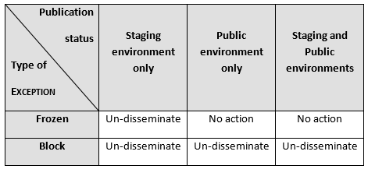
Preventative Exceptions

Slide 43
C&L aka DISCLI
C&L: Classifications & labeling
DISCLI: Classification and Labelling Inventory (DISCLI)
Scope:
Selects classification and labelling information from BIDI
Filters the confidential information
Aggregates information
Publishes the processed information to ECHA’s website
DISCLI
Info Cards
Brief Profile

Slide 44
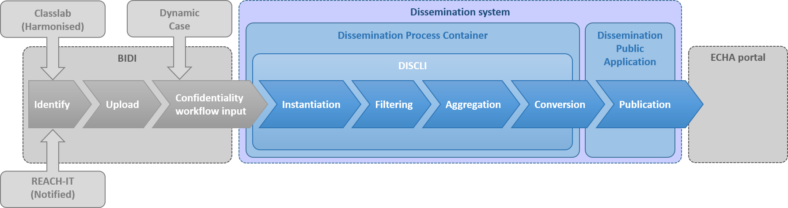
C&L: Information Flow
Input Systems:
Classlab For the Harmonised Classifications
REACH IT Notified classifications
CLP Notifications
REACH Registrations
Dynamic Case for Confidentiality Claims on IUCLID dossiers

Slide 45
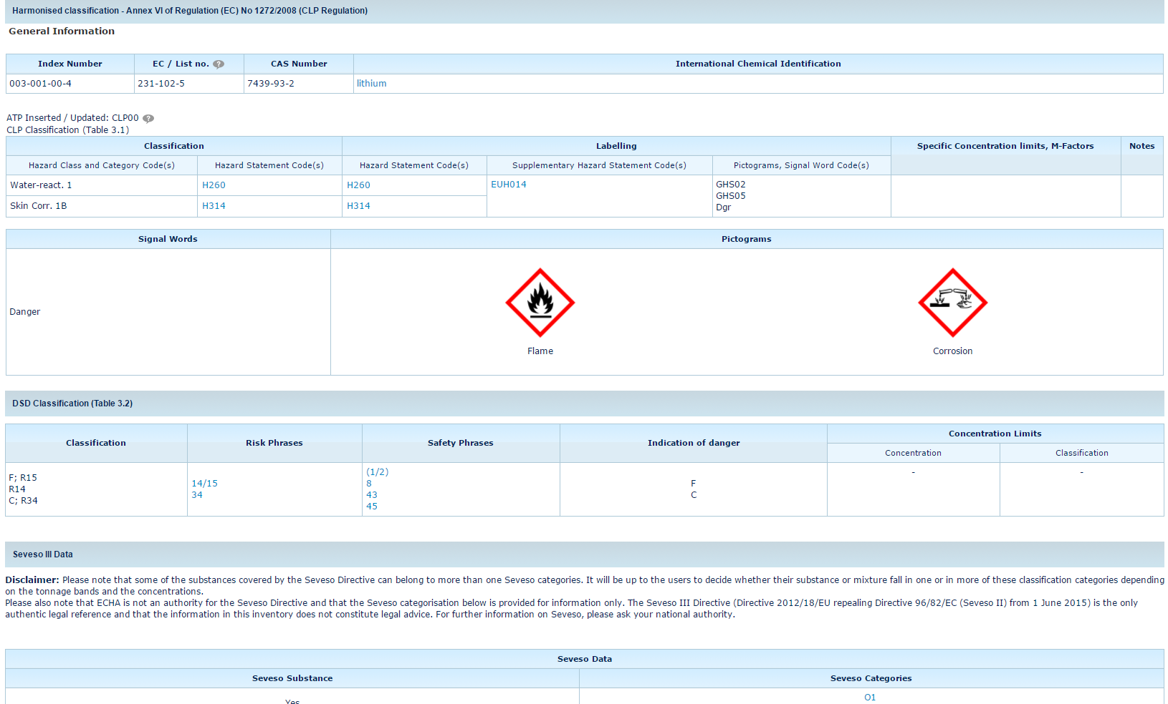
Harmonised Classification (C&L Inventory > Lithium)

Slide 46
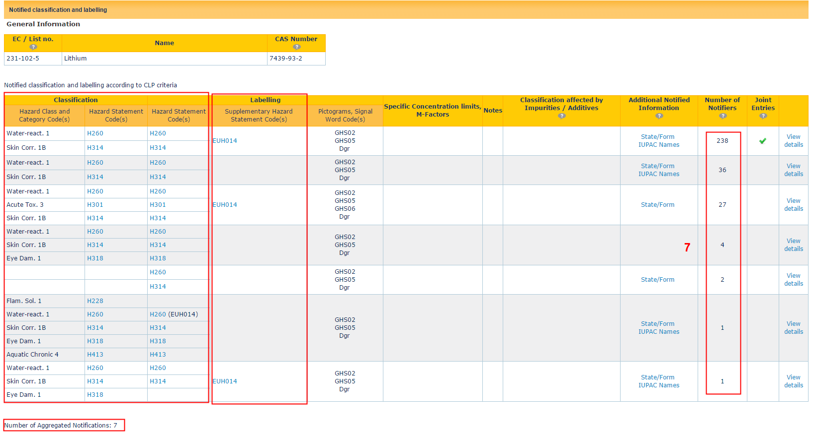
Notified Classification: C&L Inventory > Lithium

Slide 47
DISS environments
Dev Environments
Hosted by UniSystems (Citrix)
Managed by UniSystems
DEV
DEV3.1
PREVAL
QA Perf
ECHA Environments
Hosted by ECHA
Managed by Application Management Team (F.Zografos, K.Yiannakos, D.Skoufas, A.Tantalos etc.)
PROD
QA (Prod DATA from BIDI, IUCLID)
QA2 (Prod DATA from BIDI, IUCLID)
SAT (Test data)

Slide 48
References
Presentation & Material is available on Confluence, at: https://pmo.trasys.be/confluence/display/DISSEMINATION/OnBoarding+Material
Dissemination v3.0 Summary v1.6.doc (Karterina Konstantinidou)
IUCLID filtering engine
IUCLID aggregation engine
Instantiation.vsd
Presentation to Business Users (ED)
Dissemination v3.0: architecture overview (Marios Kerkemezos – ECHA)

Slide 49
Questions & Answers

